Slide 1
NETWORKING
This project is developed on the basis of real life situation that contains two buildings and the both the buildings have networks. The interconnection of the networks between these two buildings are shown as per the scenario. Each building has two floors that contains different rooms with electronic devices like PCs, Telephones, Webcams and many mores connected to the internet.

Slide 2
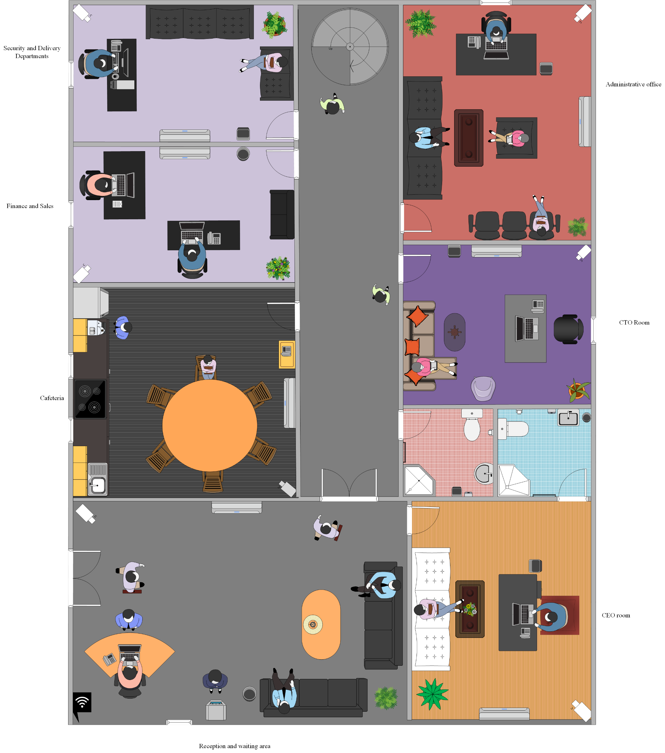
Ground floor Head Office (Pen yang)

Slide 3
Features of Ground Floor (Head office)
It consists of reception area, waiting room, Cafeteria, Security and Delivery room, CEO room, CTO room, Finance and sales room, administrative office.
Each room with the corridor area are continuously monitored with the help of high-quality CCTV.
Waiting room has pleasant sitting arrangement with Wi-Fi access point and water dispenser.
It has a Wi-Fi access point on the reception area which allows any one to easily access to the internet.

Slide 4
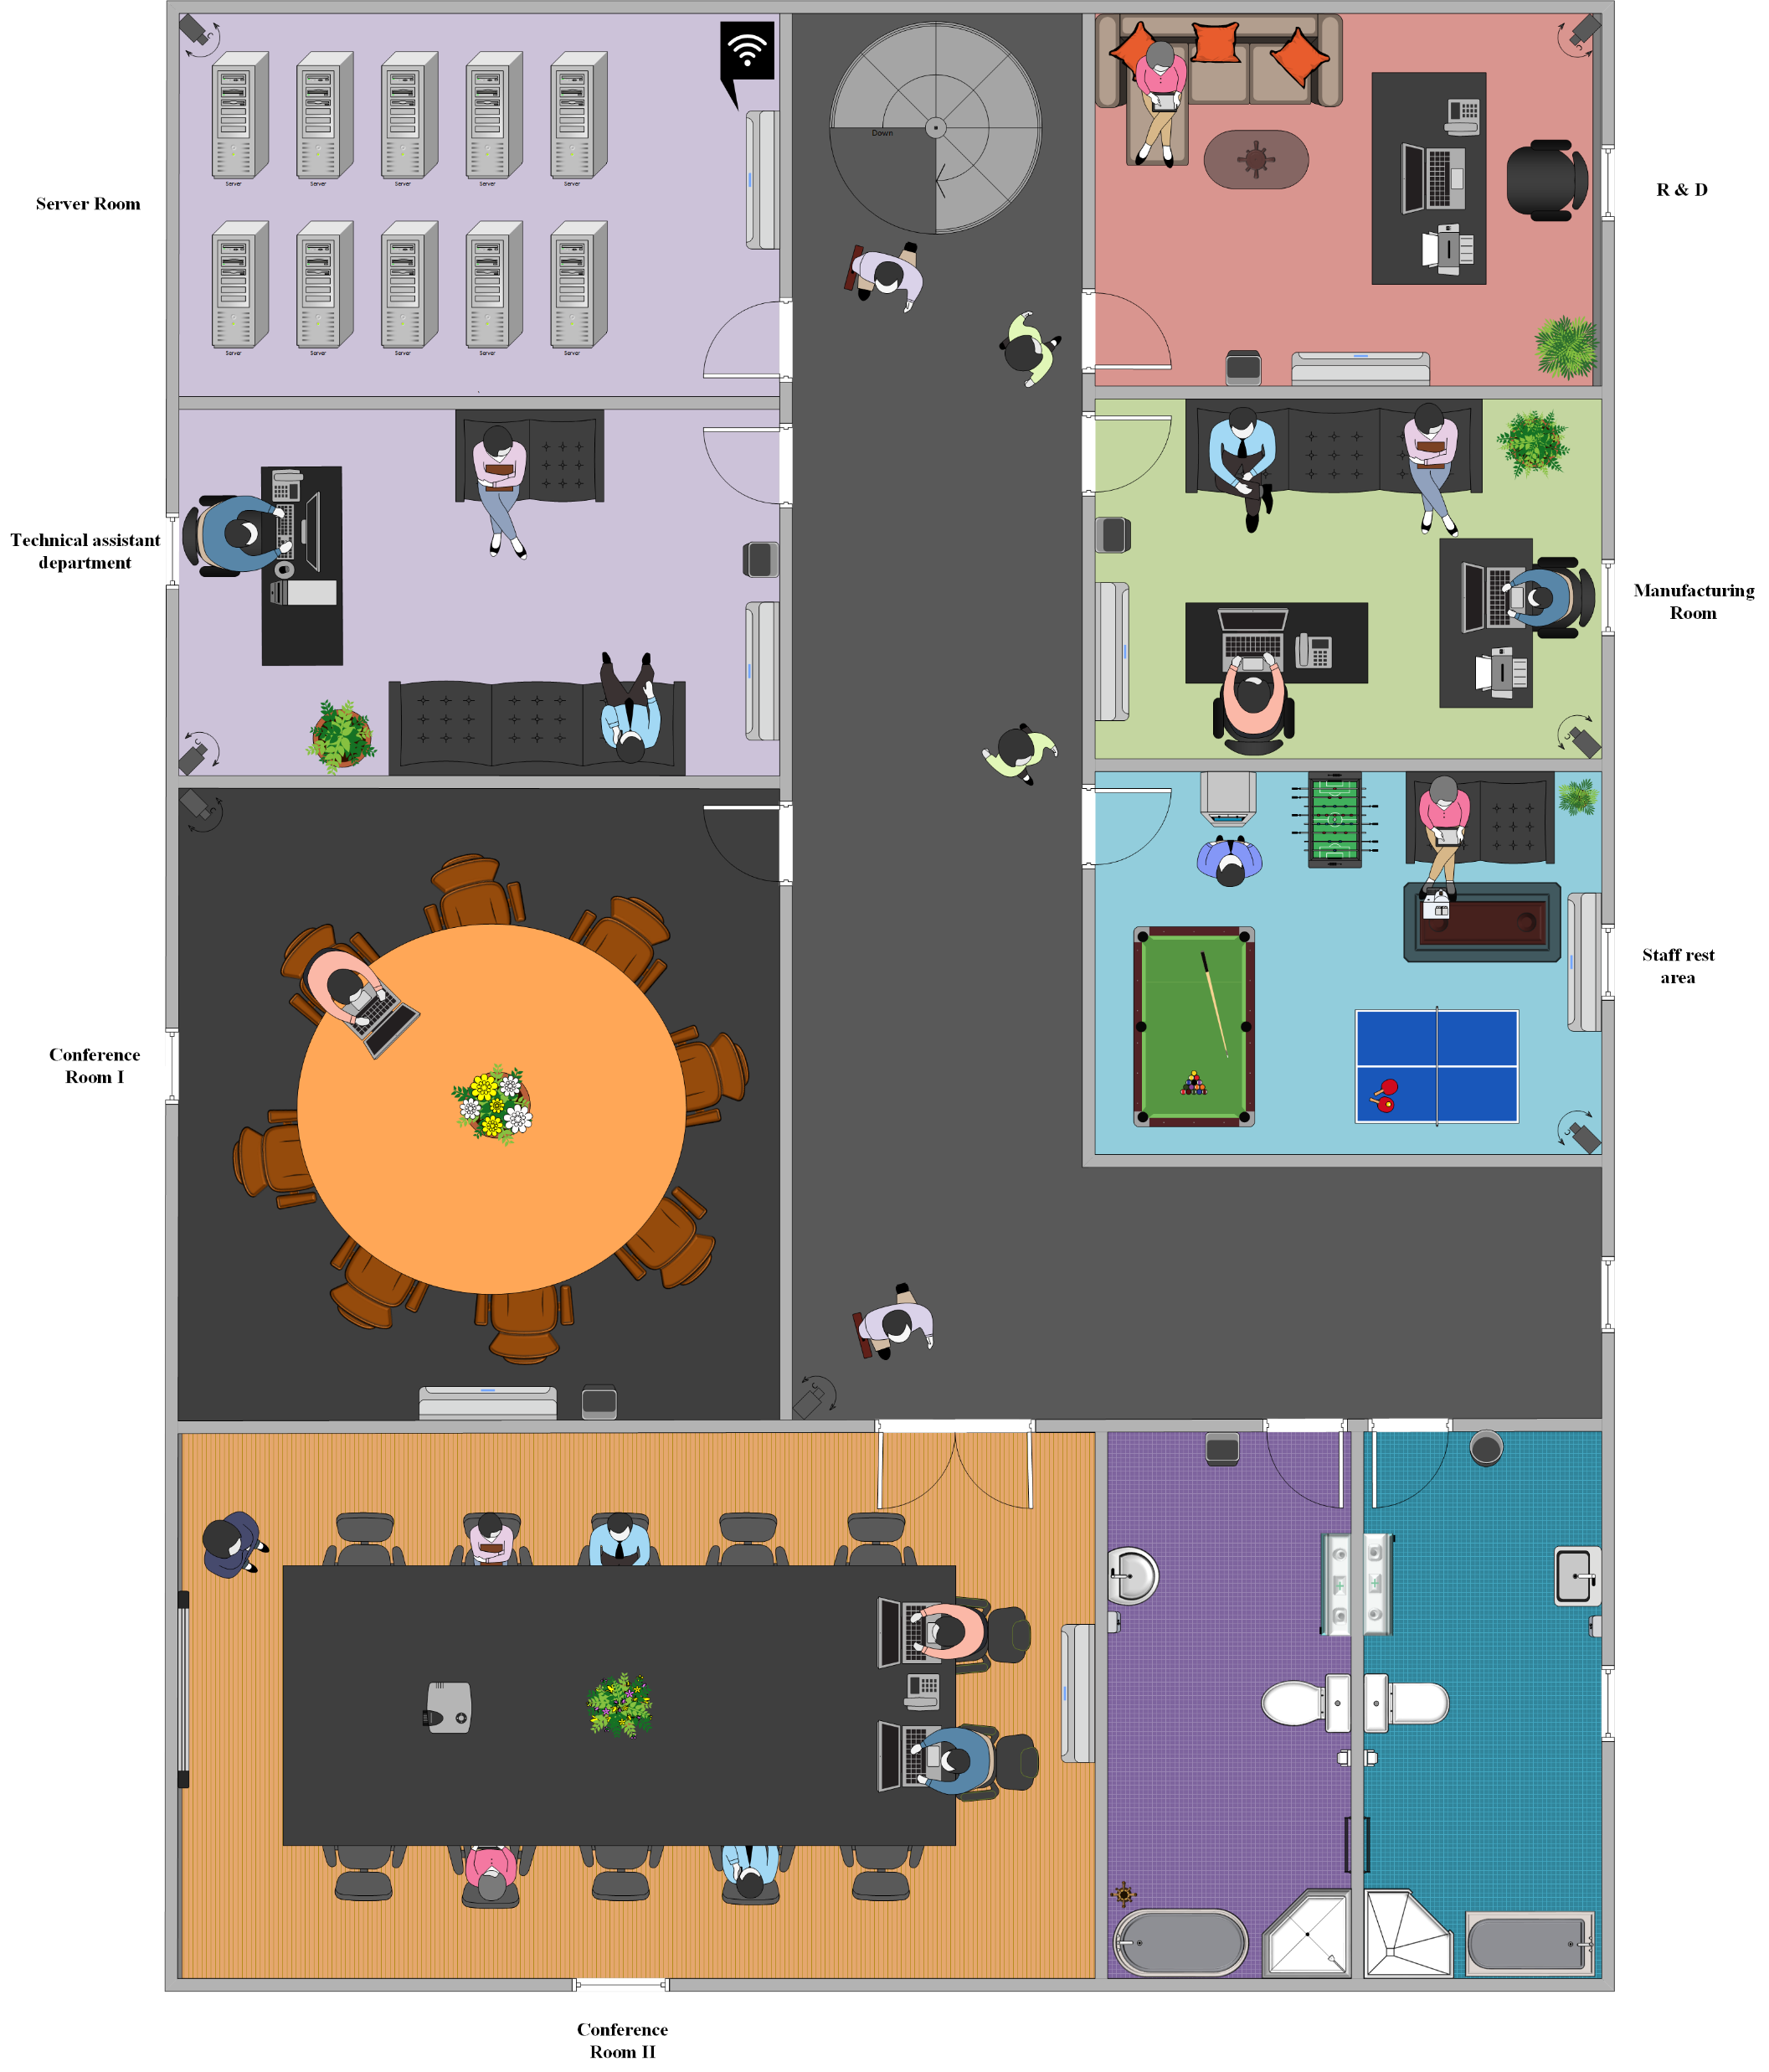
First floor Head office(Pen yang)

Slide 5
Features of First Floor (Head Office)
First floor consists of seven rooms with two conference room, a Server room, a research and design room, Manufacturing room, a technical assistant room and a staff rest area.
The main conference room consist of router for good network strength and a display projector
Main conference room is used for general meeting between all the staffs or with costumers and staffs while other conference room is used for small meetings conducted within departments.
The staff rest area consist of a snooker and a table tennis board which helps staff for refreshment and reenergise themselves.

Slide 6
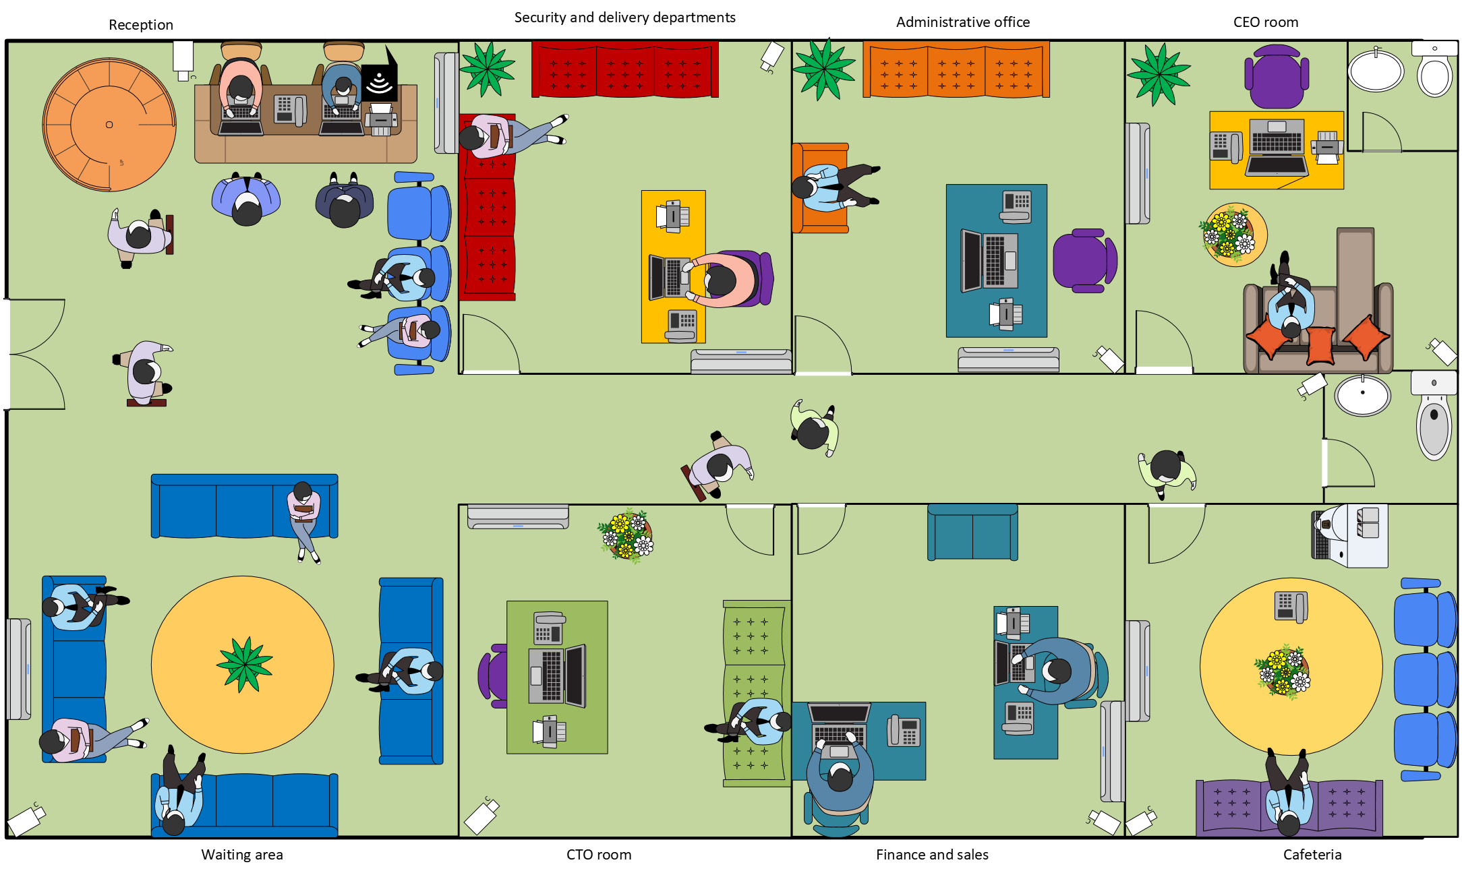
Branch office Ground Floor (Cyberjaya)

Slide 7
Features of ground floor (Branch office )
It consists of reception area, waiting room, Cafeteria, Security and Delivery room, CEO room, CTO room, Finance and sales room, administrative office.
Each room with the corridor area are continuously monitored with the help of high-quality CCTV.
Delivery department is on the ground floor and near to the waiting room so that costumer can have quick access
Rest room at the end of corridor is easily visible and accessible for everyone.

Slide 8
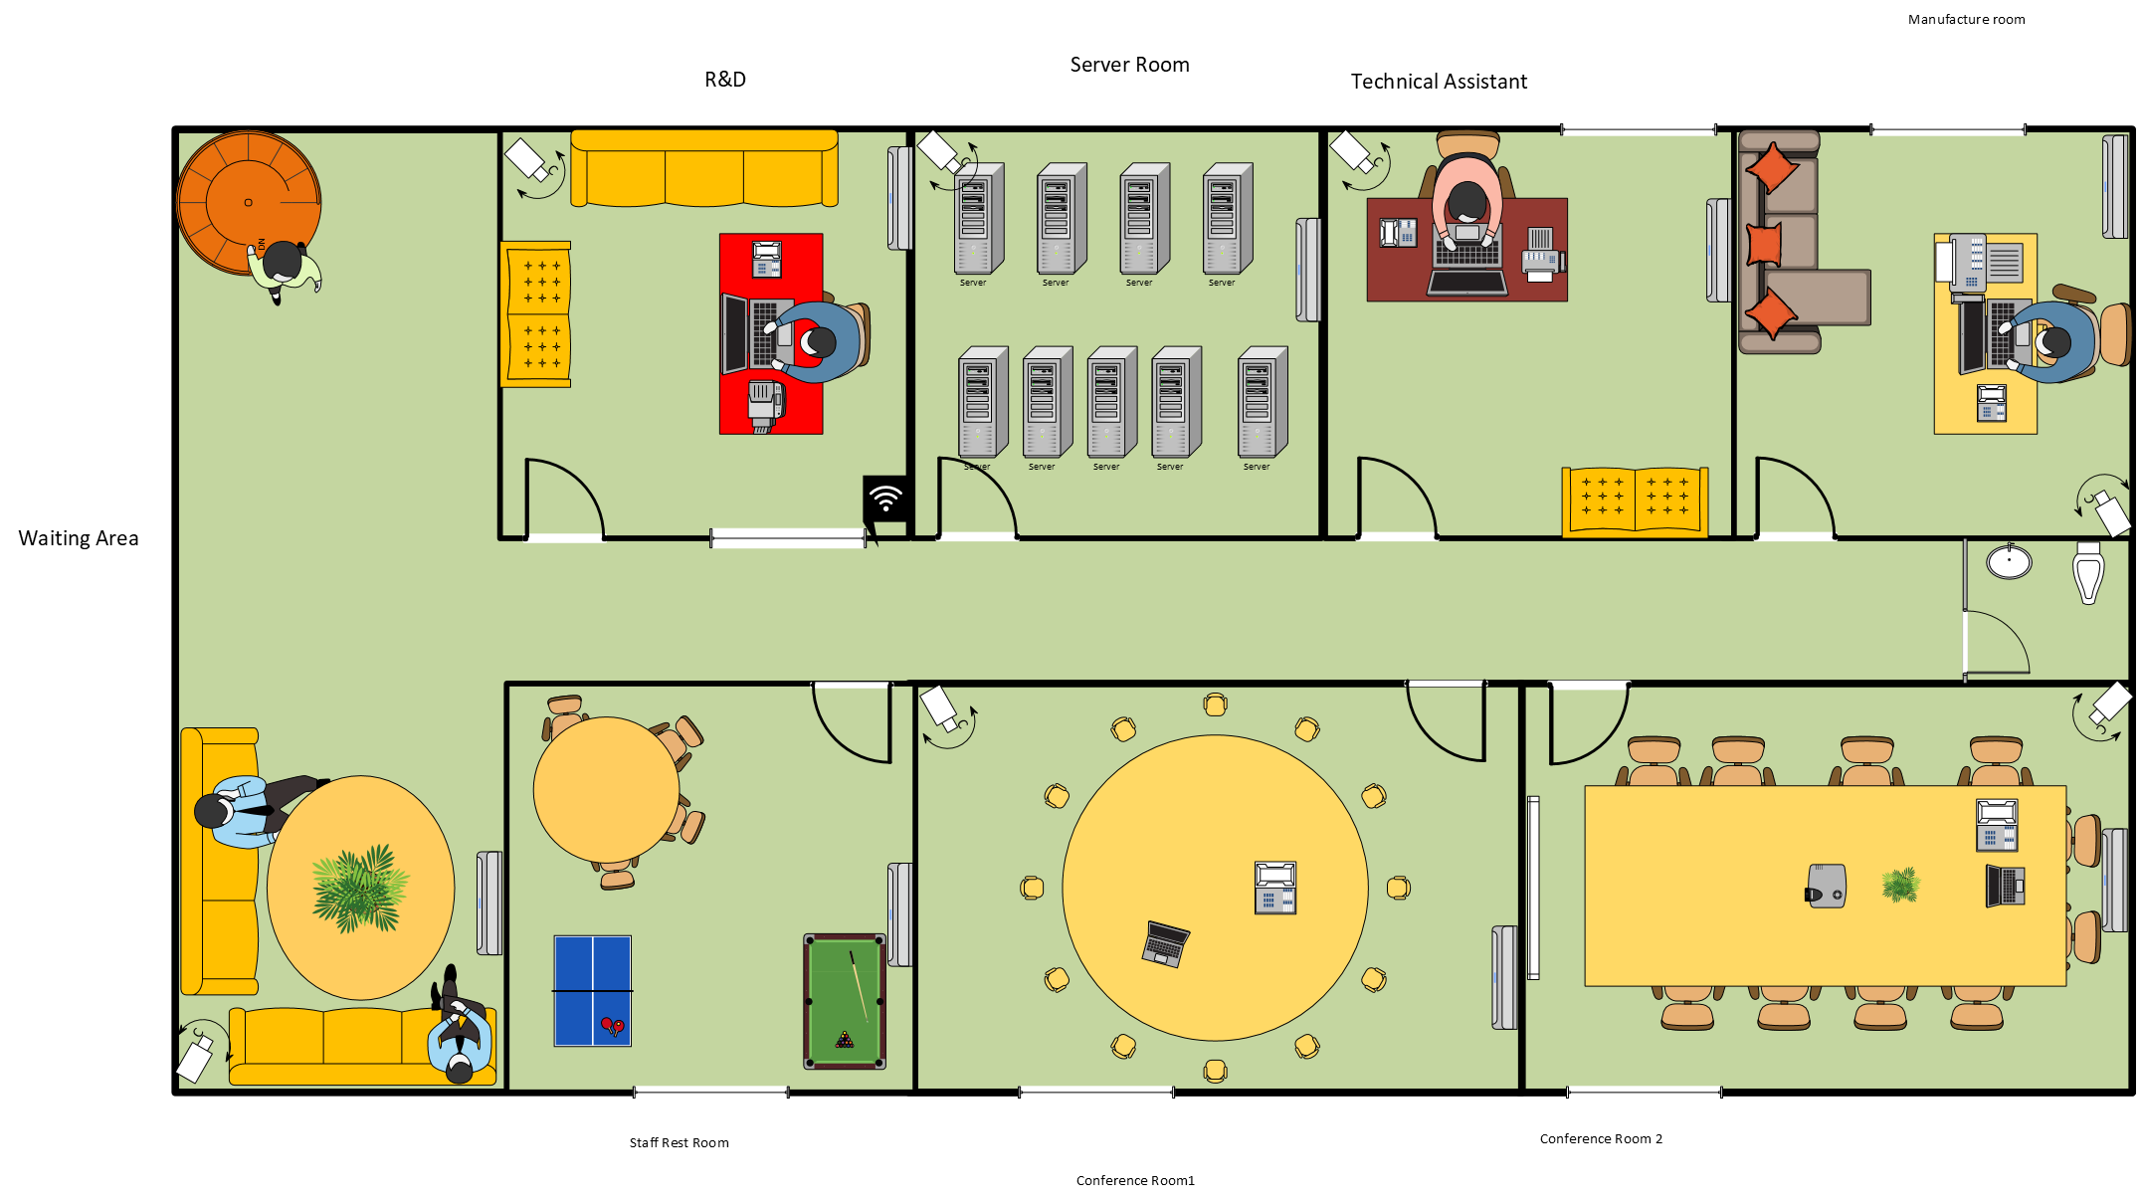
First floor Branch Office(Pen yang)

Slide 9
Features Of First floor (Cyberjaya)
First floor consists of seven rooms with two conference room, a Server room, a research and design room, Manufacturing room, a technical assistant room and a staff rest area.
Three switch are used in this floor and end devices are joined with star topology. Each room are monitored with high quality CCTV.
A small waiting room with a table two sofa and air conditioner gives pleasant feeling to the visitors and costumer.

Slide 10
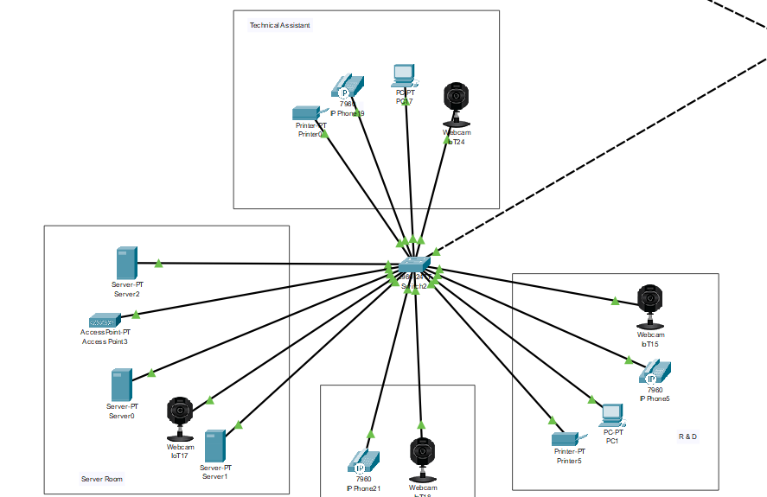
Star Topology

Slide 11
Star Topology has been used entirely on the networking
Advantages
simplicity in its management and maintenance.
( Since each end device has separate connection so failures affects a single device and is easy to detect and maintain.)
Here failure of connection in one device doesn’t affect entire connection.
Has higher reliability compared other topologies in long run.

Slide 12
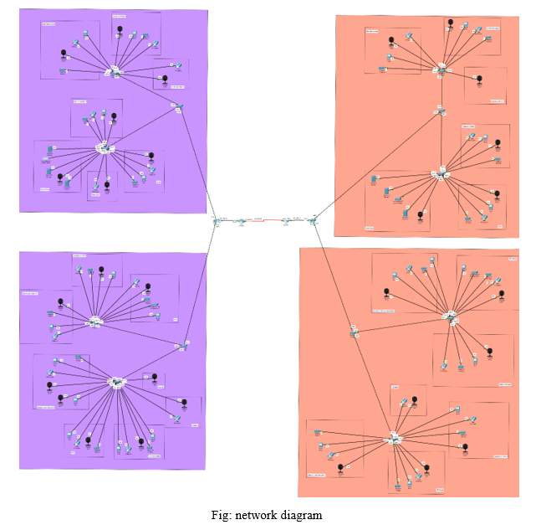
Figure Showing Entire Networking Diagram of The Project

Slide 13
Dynamic Host Configuration Protocol (DHCP):
It is the rule by which end devices connecting to the network are automatically assigned with the Ip- address, subnet mask, default gateway etc.
DHCP servers are costly for organizations. Thus, router configuration is done to activate DHCP services.
We did the DHCP configuration in our router1 and router2.

Slide 14
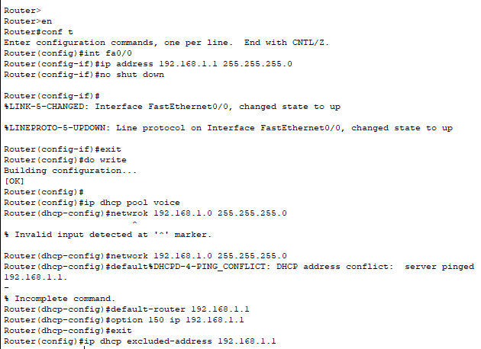

Slide 15
Cisco Telephony
The VOIP phones are connected to the switch which is then directly connected to the router. Then the telephony configuration is done on the router and the IP phone is automatically assigned to the VOIP phone system

Slide 16
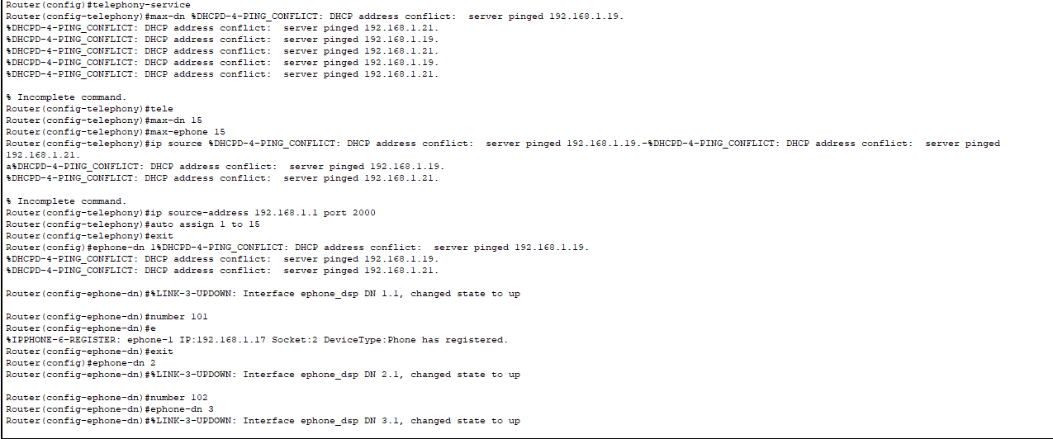

Slide 17
Serial Configuration
The serial configuration is done on the routers because the serial configuration is slightly faster than the other configurations. We added clock rate and bandwidth in this configuration to manage the time between two frames and maintain the speed respectively.

Slide 18
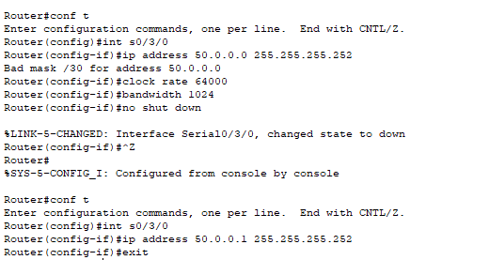

Slide 19
Router RIP configuration
It is a simultaneous routing protocol. In OSI model it performs its task on network layer. It helps to find the shortest way between the source and the destination network. It is easy to configure and is not complicated. Its system of measurement is based on trip count basis which is maximum 15. It is not suitable for very large-scale organization or network because it is not scalable.

Slide 20
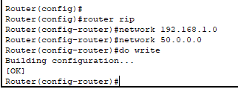

Slide 21
Dial Peer Configuration
Dial Peer Configuration is the gate way for processing any sort of dial plans and providing voice services over an IP packet network. Call source and destination endpoints are identified by using dial peers, it is also used for defining the characteristics applied to each call leg in call connection. Dial peers are considered a crucial component of VoIP.
For configuring VoIP dial peer, you must identify the dial peer by appointing it a unique tag number, defining its designated telephone number and its destination IP address.

Slide 22
Switchport Voice VLAN
A voice VLAN is particularly assigned for voice data stream. It focusses to ensures the quality of voice traffic. The priority is always given to voice service although other data forms like video can transfer simultaneously. Source address of received voice packets and VLAN tags of the received packets are used to distinguish voice data streams.

Slide 23
